Slide 1
Food Safety Manager’s/Supervisor’s Course (FSMC) CANTRAC B-322-2101 Request to Instruct Mar 01, 2023

Slide 2
REFERENCES
OPNAVINST 4061.4/MCO 4061.1, Food Safety Training Program
Tri-Service Food Code (NAVMED P-5010-1) 01March2019
https://www.med.navy.mil/Navy-Marine-Corps-Public-Health-Center/Preventive-Medicine/Program-and-Policy-Support/Food-Sanitation-and-Safety/

Slide 3
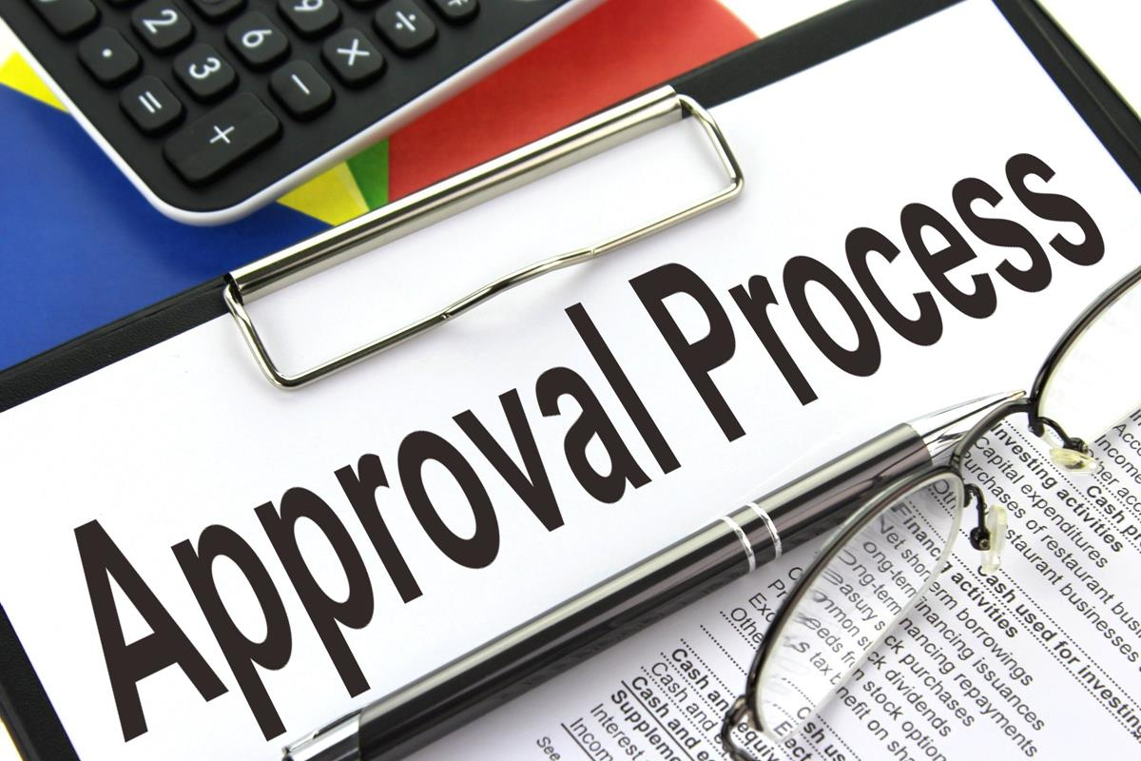
APPROVAL TO INSTRUCT
BLUF
Approval to instructed is granted by the Defense Center for Public Health – Portsmouth (DCPH-P) Program Manager.
Approval will be granted if perspective instructor meets all requirements set forth by DCPH-P Program Manager.
Perspective instructors must submit the required information via their senior Preventive Medicine Authority at their installation.

Slide 4
PROSPECTIVE INSTRUCTOR MUST MEET ALL PREREQUISITES
EHO/PMT/IDC assigned to a Navy Medicine facility with applicable educational background;
E4 or above with a minimum of 1 year of food inspection experience.
Successful completion of the CANTRAC B-322-2101, Food Safety Manager/Supervisor Course (FSMC) within the previous 5 years.
Score 90% or above on the FSMC examination.

Slide 5
PROSPECTIVE INSTRUCTORS MUST SUBMIT ALL OF THE FOLLOWING:
The DCPH-P instructor biographical data (BIO) form.
The official DCPH-P approved examination results.
A copy of the course completion certificate.
An email from the senior PMA (PMA is defined as the medical department representative responsible for public health) endorsing the instructor request.

Slide 6
PROSPECTIVE INSTRUCTORS MUST SUBMIT ALL OF THE FOLLOWING TO:
usn.hampton-roads.navmcpubhlthcenpors.list.nmcphc-foodsafetymana@mail.mil

Slide 9
QUESTIONS
Point of Contact:
usn.hampton-roads.navmcpubhlthcenpors.list.nmcphc-foodsafetymana@mail.mil

